Slide 1
Chapter 30

Slide 2
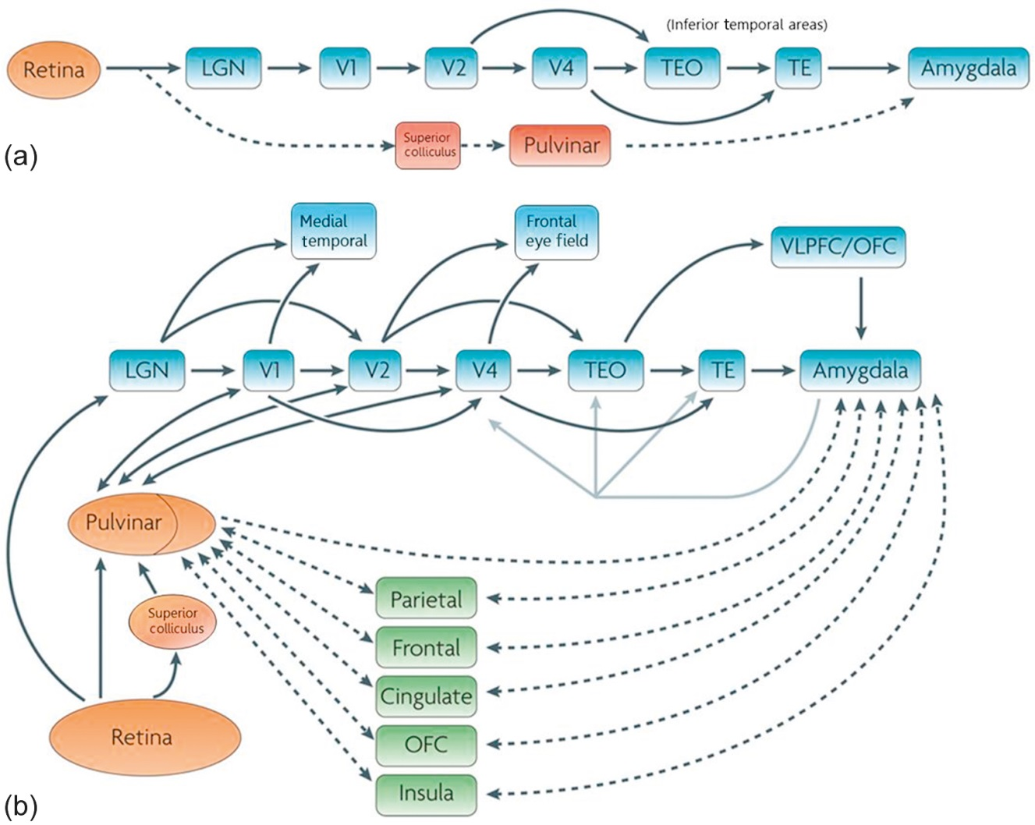
Figure 1 The standard hypothesis is represented by (a) a subcortical pathway comprised of the superior colliculus and the pulvinar nucleus of the thalamus leads directly to the amygdala—provoking a fast and automatic response. The alternative view is represented by (b) the idea that the flow of visual information occurs via multiple different pathways, including alternative routes and shortcuts—giving rise to the understanding of a “multiple waves of activation” approach.
Reprinted with modifications from Ref. 4, Copyright (2011), with permission from Elsevier.

Slide 3
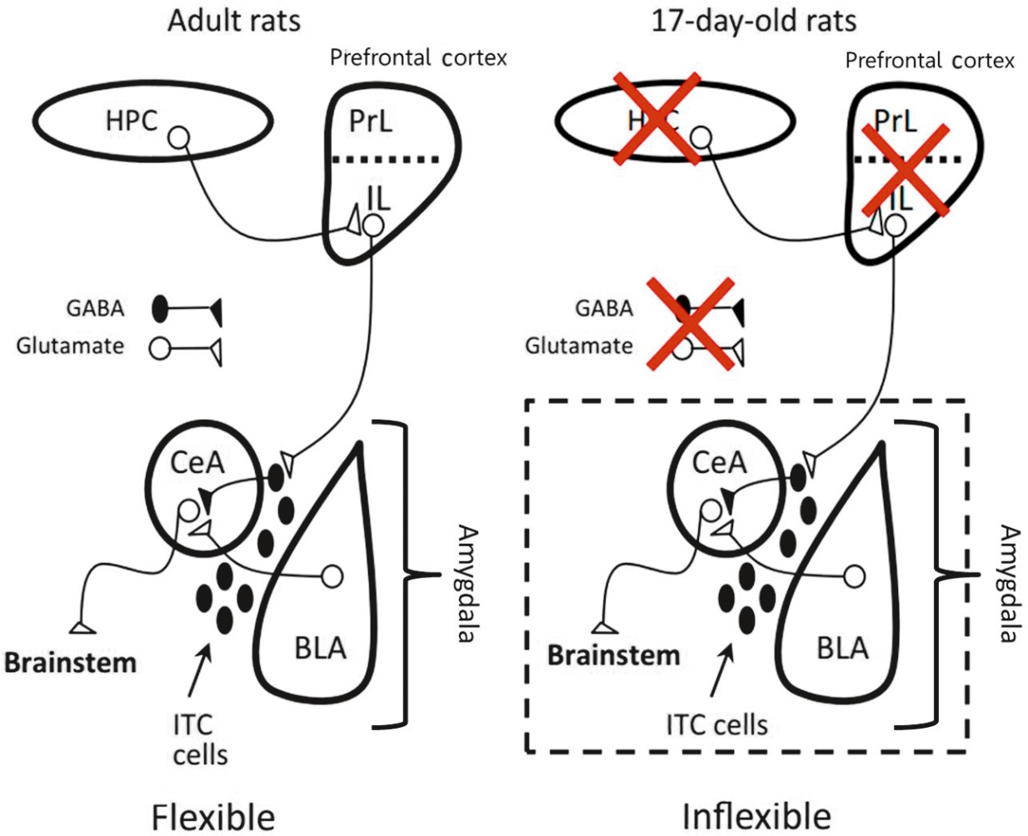
Figure 2 The neural structures activated in extinction of conditioned fear are similar in P24 and adult rats. The process begins with hippocampal modulation of the vmPFC, which then controls projections to the amygdala in order to modulate the fear extinction. However, in P17 rats (i.e., young rats) extinction occurs independently of the hippocampus and vmPFC, suggesting a greater reliance on only the amygdala for extinction learning at this age.
Reprinted with modifications from Ref. 15, Copyright (2010), modified with permission from Ref. 16, Copyright (2004), with permission from Elsevier.

Slide 4
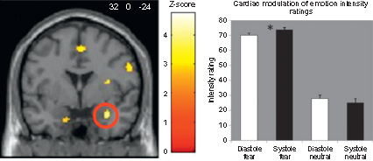
Figure 3 The image on the left shows increased activation in bilateral amygdala, in particular the right side (circled), during emotion processing, in relation to the presentation of emotional faces at systole and diastole. The graph depicts this interaction between perception of emotional intensity and cardiac timing; fear faces were rated as more intense during systole, while neutral faces were more intense at diastole.
Reprinted with modifications from Ref. 23
with permission from The Journal of Neuroscience.

Slide 5
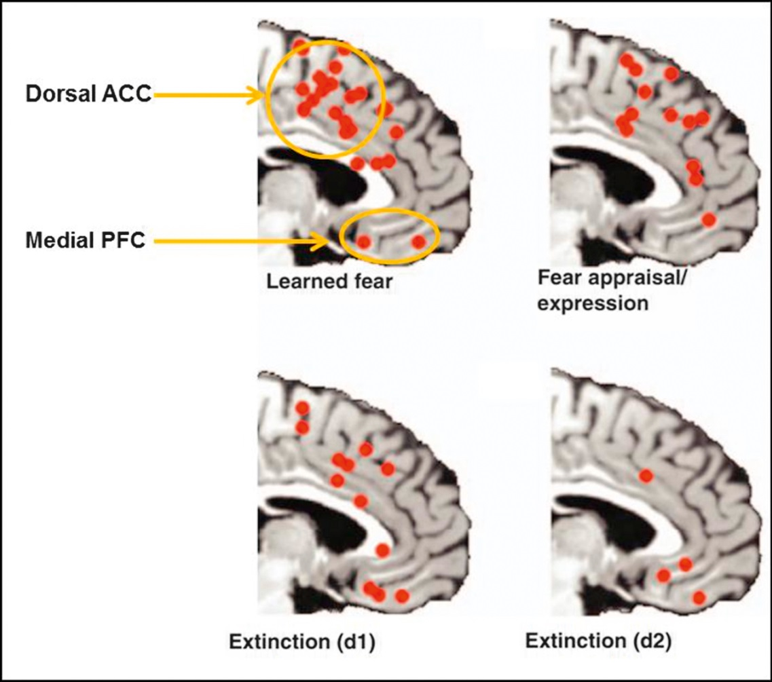
Figure 4 Display of areas activated during fear regulation. Dorsal ACC/mPFC activity is seen during classical fear conditioning. This is also the case during the appraisal and expression of fear. With regard to fear extinction, the focus of activation is the dorsal and ventral ACC/mPFC (d1). This remains true for subsequent delayed recall and expression of the memory of the extinction (d2).
Reprinted with modifications from Ref. 31, Copyright (2011) with permission from Elsevier.

